Slide 1

INTEL UNNATI TRAINING PROGRAM
TEAM
NEW FLORAISON
LOKESHWARAN.S
KEERTHANA.R
NAVEEN.B

Slide 2






AGENDA SLIDE
PROBLEM STATEMENT
INTRODUCTION
LITERATURE SURVEY
SOFTWARE IMPLEMENTATION
OBJECTIVE
OUTCOMES
CHALLENGES
CONCLUSION

Slide 3
PROBLEM STATEMENT
India ranks first in the world for the number of accidents and lives lost on the roads. The country has only 1% of the vehicles in the world but has 11% of the accidents in the world. Ministry of Road Transport (MoRTH) uses the concept of Blackspot to mark the accident locations to improve road safety on national highways in the country.
And, here we are going to provide a map with the accident prone locations are marked using the MoRTH data and the GIS software for plotting those blackspots.

Slide 4

INTRODUCTION
India is the second-most populous country in the world. It needs to do a lot of work to increase traffic safety and prevent accidents. In India, traffic accidents are now a serious public health concern due to the significant number of deaths, injuries, and monetary losses they produce.
Here we are going to mark the accident locations on india using the MoRTH data and GIS software to identify the high risk areas, that helps the policymakers, urban planners and the transportation authorities can get valuable insights to execute the targeted interventions and enhance road safety measures.

Slide 5
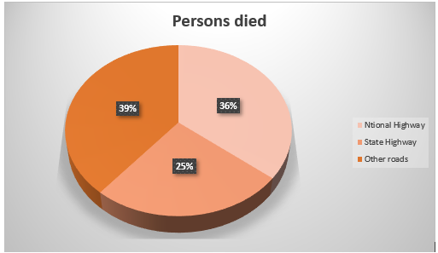
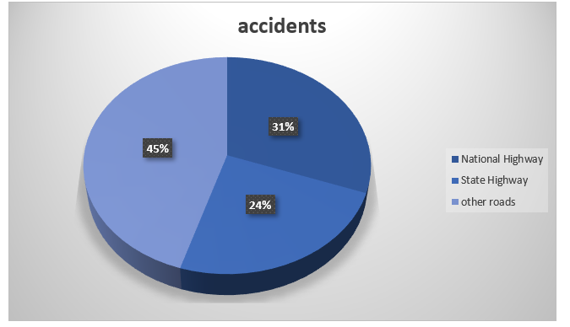
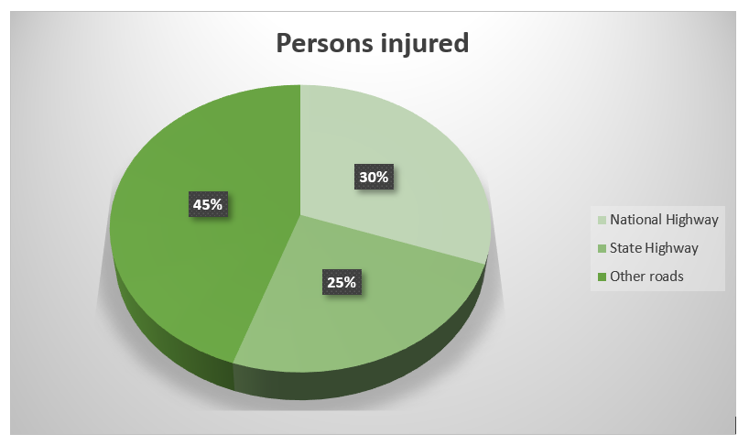
LITERATURE SURVEY
The survey was conducted in 2019, according to this assessment of literacy. About 4,49,002 incidents occur over 62,15,797 kilometres, and 4,51,361 people die in accidents. The impact on accidents involving persons was significant as a result. Accidents are the human community's leading source of misery, according to this survey table.

Slide 6
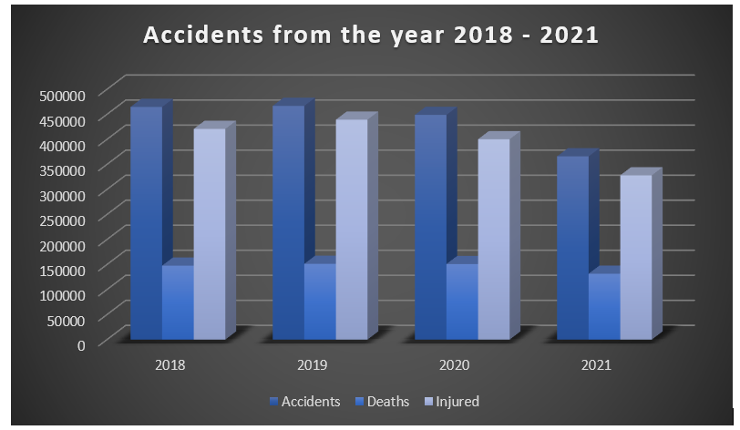
This bar graph illustrates the accidents that are distributed over the years from 2018 to 2021, nearly four years and also the no. of deaths and persons got injured.

Slide 7
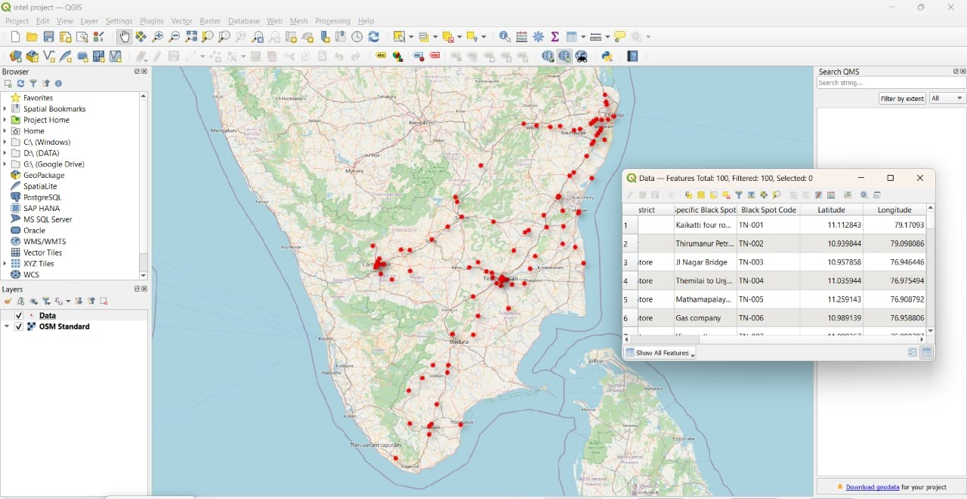
SOFTWARE IMPLEMENTATION
Geographic Information System is a valuable tool for mapping blackspots on a map. GIS is used to collect, store, verify, and display information about positions on the surface of the Earth.
With the help of this GIS software we can plot the blackspots in the map.
Select a specific country or city or area, where we are going to find the accident locations. Here we take our country, that is India.
Import the accident data from MoRTH(Ministry of Road, Transport and Highways) and then analyse the data.
By using this analysed data and the tools of GIS, we can plot the accident locations on the India map.

Slide 8
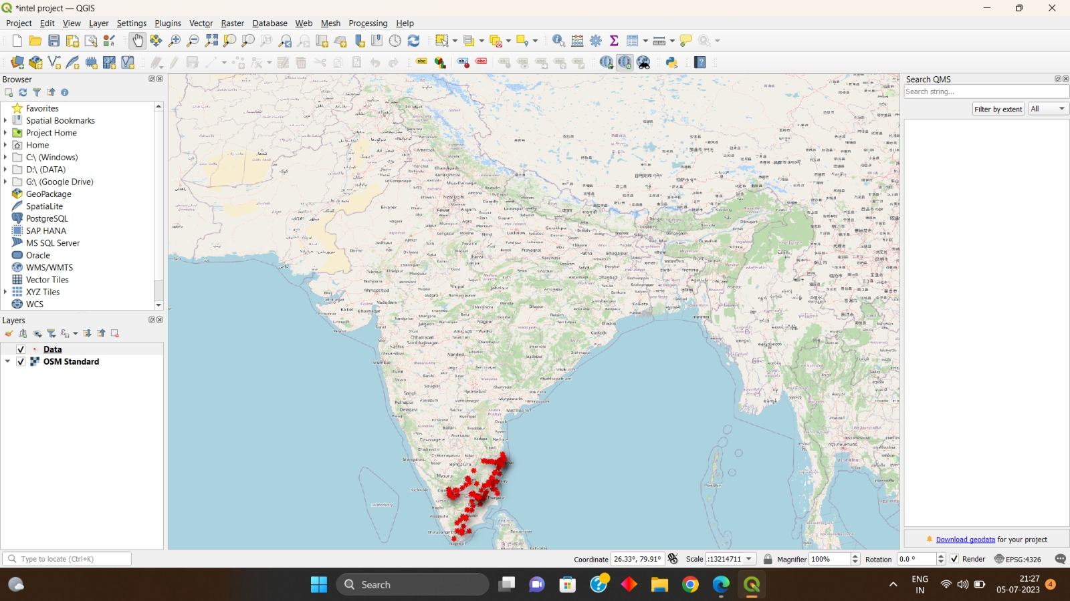
ACCIDENT LOCATIONS THAT ARE MARKED ON THE MAP

Slide 9

OBJECTIVE
The sites of accidents in India must be identified and studied in order to implement targeted actions and strategies to reduce casualties, increase road safety, and prevent accidents.
The primary objective of identifying accident locations in India is to create safer roadways, save lives, and reduce the social and economic costs associated with accidents. By understanding where accidents occur and why, stakeholders can work collaboratively to implement measures that minimize the risk of accidents and create a safer transportation system.

Slide 10
OUTCOMES
The outcomes of plotting the accident prone locations on the map includes the following :
Identification of Accident Hotspots.
Analysis of Regional Accident Patterns.
Correlation with Infrastructure and Population Density.
Reduction in accidents and deaths due to accidents.
Route Planning and Road Safety Assessment.
Data-Driven Decision Making.

Slide 11
CHALLENGES
India's accident sites encounter a variety of difficulties that can be linked to a number of variables. The following are some of the main issues with accident sites in India:
Poor Infrastructure.
Traffic Congestion.
Insufficient Enforcement of Traffic Laws.
Lack of Awareness and Education.
Poor Road Safety Culture.
Inadequate Emergency Response.
Encroachment and Pedestrian Safety.

Slide 12

CONCLUSION
In conclusion, India has experienced countless mishaps in a variety of places recently. Roads, railroads, waterways, as well as industrial and residential locations have all seen these catastrophes happen. Depending on factors like population density, infrastructure, and human error, some places have a higher number of accidents. To lower the frequency and severity of accidents, it is crucial for authorities to concentrate on enhancing safety precautions.
Here we are addressing the issues of accidents in India and ensuring the welfare and safety of its population requires a concerted effort from all parties. Then, using the MoRTH data and GIS tools, we drew the accident locations on Indian highways. The accident sites in India that were identified using GIS software are helpful for the policy makers, urban planners and transportation authorities to enhance the safety measures and for new safety interventions.

